Slide 1
Joins in SQL

Slide 2
Joins on Multiple Tables:
SQL provides a convenient operation to retrieve information from multiple tables.
This operation is called join.
The join operation will combine the tables into one large table with all possible combinations (Math: Cartesian Product), and then it will filter the
rows of this combined table to yield useful information.

Slide 3
Join Concepts
Combine rows from multiple tables by specifying matching criteria
Usually based on primary key – foreign key relationships
For example, return rows that combine data from the Employee and SalesOrder tables by matching the Employee.EmployeeID primary key to the SalesOrder.EmployeeID foreign key
It helps to think of the tables as sets in a Venn diagram
Sales orders that were taken by employees
Employee
SalesOrder

Slide 4
Different type of Joins
Cross Join
Inner Join
i. Equi/Equality join (‘=‘)
ii. Natural join
iii. Theta join (or non-equi join (<, <=, >, >=, <>))
3. Outer Join
i. Left outer join
ii. Right outer join
iii. Full outer join
4. Self Join
5. Semi Join

Slide 5
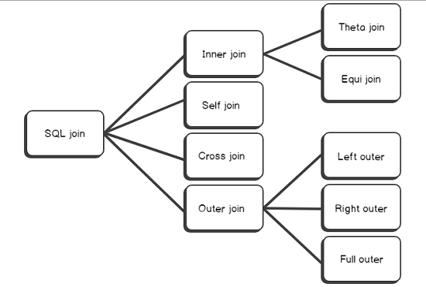
Different type of Joins

Slide 6
Multiple Tables:
field1
field2
A
1
field1
field2
A
2
A
1
A
3
2
B
B
1
3
B
2
B
3

Slide 7
What kind of Join is this?
SELECT *
FROM Students S ?? Enrolled E;
S
S.name | S.sid
Jones | 11111
Smith | 22222
E
E.sid | E.classid
11111 | History105
11111 | DataScience194
22222 | French150
S.name | S.sid | E.sid | E.classid
Jones | 11111 | 11111 | History105
Jones | 11111 | 11111 | DataScience194
Jones | 11111 | 22222 | French150
Smith | 22222 | 11111 | History105
Smith | 22222 | 11111 | DataScience194
Smith | 22222 | 22222 | French150

Slide 8
The CROSS JOIN is used to generate a paired combination of each row of the first table with each row of the second table. This join type is also known as cartesian join.
SELECT *
FROM Students S CROSS JOIN Enrolled E;
S
S.name | S.sid
Jones | 11111
Smith | 22222
E
E.sid | E.classid
11111 | History105
11111 | DataScience194
22222 | French150
S.name | S.sid | E.sid | E.classid
Jones | 11111 | 11111 | History105
Jones | 11111 | 11111 | DataScience194
Jones | 11111 | 22222 | French150
Smith | 22222 | 11111 | History105
Smith | 22222 | 11111 | DataScience194
Smith | 22222 | 22222 | French150

Slide 9
Inner Joins
Return only rows where a match is found in both input tables
Match rows based on attributes supplied in predicate
If join predicate operator is =, then it known as equi-join
SELECT emp.FirstName, ord.Amount
FROM Employee emp
[INNER] JOIN SalesOrder ord
ON emp.EmployeeID = ord.EmployeeID
Set returned by inner join
Employee
SalesOrder

Slide 10
SQL Inner Joins (Equi join)
SELECT S.name, E.classid
FROM Students S (INNER) JOIN Enrolled E
ON S.sid=E.sid
S
S.name | S.sid
Jones | 11111
Smith | 22222
Brown | 33333
E
E.sid | E.classid
11111 | History105
11111 | DataScience194
22222 | French150
NULL | English10
S.name | E.classid
Jones | History105
Jones | DataScience194
Smith | French150
Note the previous version of this query (with no join keyword) is an “Implicit join”

Slide 11
SQL Inner Joins (Equi join)
SELECT S.name, E.classid
FROM Students S (INNER) JOIN Enrolled E
ON S.sid=E.sid
S
S.name | S.sid
Jones | 11111
Smith | 22222
Brown | 33333
E
E.sid | E.classid
11111 | History105
11111 | DataScience194
22222 | French150
NULL | English10
S.name | E.classid
Jones | History105
Jones | DataScience194
Smith | French150
Unmatched keys
Notes:
Missing (unmatched) key values

Slide 12
Joins and Inference
Chaining relations together is the basic inference method in relational DBs. It produces new relations (effectively new facts) from the data:
SELECT S.name, M.mortality
FROM Students S, Mortality M
WHERE S.Race=M.Race
S
M
Name | Race
Socrates | Man
Thor | God
Barney | Dinosaur
Blarney stone | Stone
Race | Mortality
Man | Mortal
God | Immortal
Dinosaur | Mortal
Stone | Non-living

Slide 13
Joins and Inference
Chaining relations together is the basic inference method in relational DBs. It produces new relations (effectively new facts) from the data:
SELECT S.name, M.mortality
FROM Students S, Mortality M
WHERE S.Race=M.Race
Name | Mortality
Socrates | Mortal
Thor | Immortal
Barney | Mortal
Blarney stone | Non-living

Slide 14
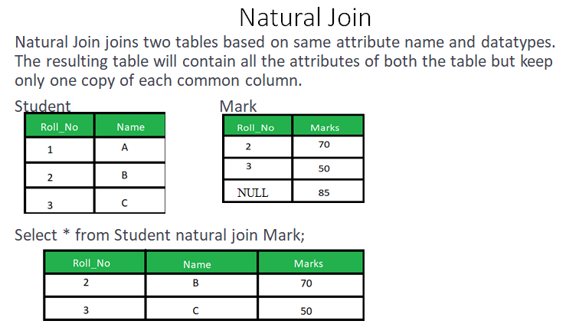
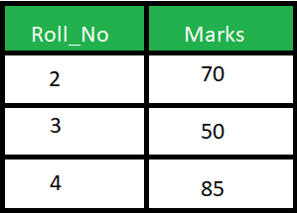

Slide 15
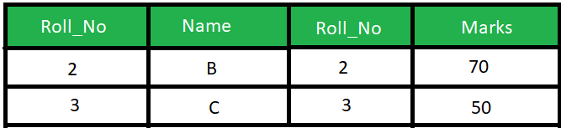
Difference between Equi join and Natural join
SELECT * FROM student S INNER JOIN Marks M ON S.Roll_No = M.Roll_No;
1. | Natural Join joins two tables based on same attribute name and datatypes. | Inner Join joins two table on the basis of the column which is explicitly specified in the ON clause.
2. | In Natural Join, The resulting table will contain all the attributes of both the tables but keep only one copy of each common column | In Inner Join, The resulting table will contain all the attribute of both the tables including duplicate columns also
3. | In Natural Join, If there is no condition specifies then it returns the rows based on the common column | In Inner Join, only those records will return which exists in both the tables
4. | SYNTAX: SELECT * FROM table1 NATURAL JOIN table2; | SYNTAX: SELECT * FROM table1 INNER JOIN table2 ON table1.Column_Name = table2.Column_Name;

Slide 16
What kind of Join is this?
SELECT *
FROM Students S, Enrolled E
WHERE S.sid <= E.sid
S
S.name | S.sid
Jones | 11111
Smith | 22222
E
E.sid | E.classid
11111 | History105
11111 | DataScience194
22222 | French150
S.name | S.sid | E.sid | E.classid
Jones | 11111 | 11111 | History105
Jones | 11111 | 11111 | DataScience194
Jones | 11111 | 22222 | French150
Smith | 22222 | 22222 | French150

Slide 17
Theta Joins (<, <=, >, >=, <>)
SELECT *
FROM Students S, Enrolled E
WHERE S.sid <= E.sid
S
S.name | S.sid
Jones | 11111
Smith | 22222
E
E.sid | E.classid
11111 | History105
11111 | DataScience194
22222 | French150
S.name | S.sid | E.sid | E.classid
Jones | 11111 | 11111 | History105
Jones | 11111 | 11111 | DataScience194
Jones | 11111 | 22222 | French150
Smith | 22222 | 22222 | French150

Slide 18
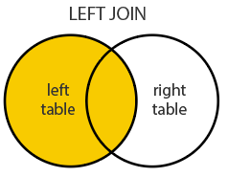
Left Outer Join
A LEFT JOIN performs a join starting with the first (left-most) table. Then, any matched records from the second table (right-most) will be included. LEFT JOIN and LEFT OUTER JOIN are the same. The result is 0 records from the right side, if there is no match.
SELECT column-names
FROM table-name1 LEFT OUTER JOIN table-name2
ON column-name1 = column-name2

Slide 19
What kind of Join is this?
SELECT S.name, E.classid
FROM Students S ?? Enrolled E
ON S.sid=E.sid
S
S.name | S.sid
Jones | 11111
Smith | 22222
Brown | 33333
E
E.sid | E.classid
11111 | History105
11111 | DataScience194
22222 | French150
NULL | English10
S.name | E.classid
Jones | History105
Jones | DataScience194
Smith | French150
Brown | NULL
Notes:
Missing (unmatched) key values

Slide 20
Query: List all students name and their classid irrespective whether they enrolled for that class or not.
SELECT S.name, E.classid
FROM Students S LEFT OUTER JOIN Enrolled E
ON S.sid=E.sid
S
S.name | S.sid
Jones | 11111
Smith | 22222
Brown | 33333
E
E.sid | E.classid
11111 | History105
11111 | DataScience194
22222 | French150
NULL | English10
S.name | E.classid
Jones | History105
Jones | DataScience194
Smith | French150
Brown | NULL
Notes:
Missing (unmatched) key values

Slide 21
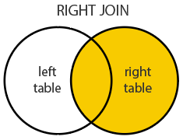
Right outer join
A RIGHT JOIN performs a join starting with the second (right-most) table and then any matching first (left-most) table records. RIGHT JOIN and RIGHT OUTER JOIN are the same. The result is 0 records from the left side, if there is no match.
SELECT column-names
FROM table-name1 RIGHT OUTER JOIN table-name2
ON column-name1 = column-name2

Slide 22
What kind of Join is this?
SELECT S.name, E.classid
FROM Students S ?? Enrolled E
ON S.sid=E.sid
S
S.name | S.sid
Jones | 11111
Smith | 22222
Brown | 33333
E
E.sid | E.classid
11111 | History105
11111 | DataScience194
22222 | French150
- | English10
S.name | E.classid
Jones | History105
Jones | DataScience194
Smith | French150
NULL | English10
Notes:
Missing (unmatched) key values

Slide 23
Query: List all students name and their classid irrespective whether for a class any student enrolled or not.
SELECT S.name, E.classid
FROM Students S RIGHT OUTER JOIN Enrolled E
ON S.sid=E.sid
S
S.name | S.sid
Jones | 11111
Smith | 22222
Brown | 33333
E
E.sid | E.classid
11111 | History105
11111 | DataScience194
22222 | French150
NULL | English10
S.name | E.classid
Jones | History105
Jones | DataScience194
Smith | French150
NULL | English10
Notes:
Missing (unmatched) key values

Slide 24
SQL Joins
SELECT S.name, E.classid
FROM Students S ? JOIN Enrolled E
ON S.sid=E.sid
S
S.name | S.sid
Jones | 11111
Smith | 22222
Brown | 33333
E
E.sid | E.classid
11111 | History105
11111 | DataScience194
22222 | French150
NULL | English10
S.name | E.classid
Jones | History105
Jones | DataScience194
Smith | French150
NULL | English10
Brown | NULL
Notes:
Missing (unmatched) key values

Slide 25
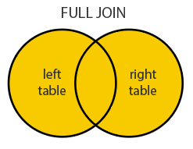
Full outer join
FULL JOIN returns all matching records from both tables whether the other table matches or not. Be aware that a FULL JOIN can potentially return very large datasets. These two: FULL JOIN and FULL OUTER JOIN are the same.
SELECT column-names
FROM table-name1 FULL OUTER JOIN table-name2
ON column-name1 = column-name2

Slide 26
Query: List all students name and their classid irrespective whether a student enrolled for a class or not, and irrespective whether for a class any student enrolled or not.
SELECT S.name, E.classid
FROM Students S FULL OUTER JOIN Enrolled E
ON S.sid=E.sid
S
S.name | S.sid
Jones | 11111
Smith | 22222
Brown | 33333
E
E.sid | E.classid
11111 | History105
11111 | DataScience194
22222 | French150
NULL | English10
S.name | E.classid
Jones | History105
Jones | DataScience194
Smith | French150
NULL | English10
Brown | NULL
Notes:
Missing (unmatched) key values

Slide 27
Self Join
A self JOIN occurs when a table takes a 'selfie', that is, it JOINs with itself. A self JOIN is a regular join but the table that it joins to is itself.
Joining a table with itself means that each row of the table is combined with itself and with every other row of the table. SELF JOINs are also useful for comparisons within a table.
SELECT column-names
FROM table-name T1 JOIN table-name T2
WHERE condition

Slide 28
Emp-id Name Manager-id
Ravi NULL
Rakul 111
Pal 111
Yuvi 113
Juri 112
Query: Return all employees and the name of the employee’s manager
SQL> SELECT e1.Name as Employee, e2.Name as Manager
FROM Employee e1 JOIN Employee e2
ON e1.Manager-id = e2.Employee-id;
Output: Employee Manager
Ravi NULL
Rakul Ravi
Pal Ravi
Yuvi Pal
Juri Rakul

Slide 29
Semi-Join
Semi join is a type of join whose result-set contains only the columns from one of the “semi-joined” tables. Each row from the first table(left table if Left Semi Join) will be returned maximum once, if matched in the second table. The duplicate rows from the first table will be returned, if matched once in the second Table. A distinct row from the first Table A will be returned no matter how many times matched in a second Table B.
The essential differences between a semi join and a regular join when we join two tables A and B are:
Semi join either returns each row from Table A, or it does not. No row duplication can occur.
Regular join returns duplicates rows if there are multiple matches on the join predicate.
Semi join returns only columns from Table A.
Regular join may return columns from either (or both) join inputs.

Slide 30
What kind of Join is this?
SELECT S.name, E.classid
FROM Students S ?? Enrolled E
ON S.sid=E.sid
S
S.name | S.sid
Jones | 11111
Smith | 22222
Brown | 33333
E
E.sid | E.classid
11111 | History105
11111 | DataScience194
22222 | French150
NULL | English10
S.name | E.classid
Jones | History105
Smith | French150
Notes:
Missing (unmatched) key values

Slide 31
SQL Joins
SELECT S.name, E.classid
FROM Students S LEFT SEMI JOIN Enrolled E
ON S.sid=E.sid
S
S.name | S.sid
Jones | 11111
Smith | 22222
Brown | 33333
E
E.sid | E.classid
11111 | History105
11111 | DataScience194
22222 | French150
NULL | English10
S.name | E.classid
Jones | History105
Smith | French150
Notes:
Missing (unmatched) key values

Slide 32
END

